Slide 1

Object Oriented Python
Classes and Objects

Slide 2
Introduction
Python is an object-oriented programming language.
Almost everything in Python is an object, with its properties and methods.
A Class is like an object constructor, or a "blueprint" for creating objects.

Slide 3
Classes
A class is a user-defined blueprint or prototype from which objects are created.
They provide a means of bundling data and functionality together.
Creating a new class creates a new type of object, allow new instances of that type to be made.
Each class instance can have attributes attached to it for maintaining its state. Class instances can also have methods (defined by their class) for modifying their state.

Slide 4
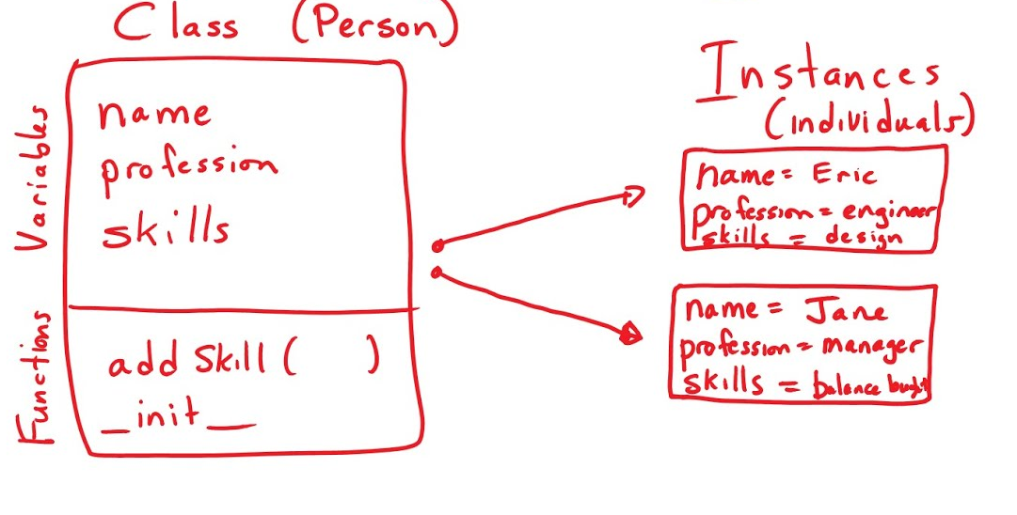
Class and Instances

Slide 5
Why create Classes?
To understand the need for creating a class in Python let’s consider an example:
Let’s say you wanted to track the number of dogs that may have different attributes like breed, and age. If a list is used, the first element could be the dog’s breed while the second element could represent its age.
Let’s suppose there are 100 different dogs, then how would you know which element is supposed to be which? What if you wanted to add other properties to these dogs? This lacks organization and it’s the exact need for classes.

Slide 6
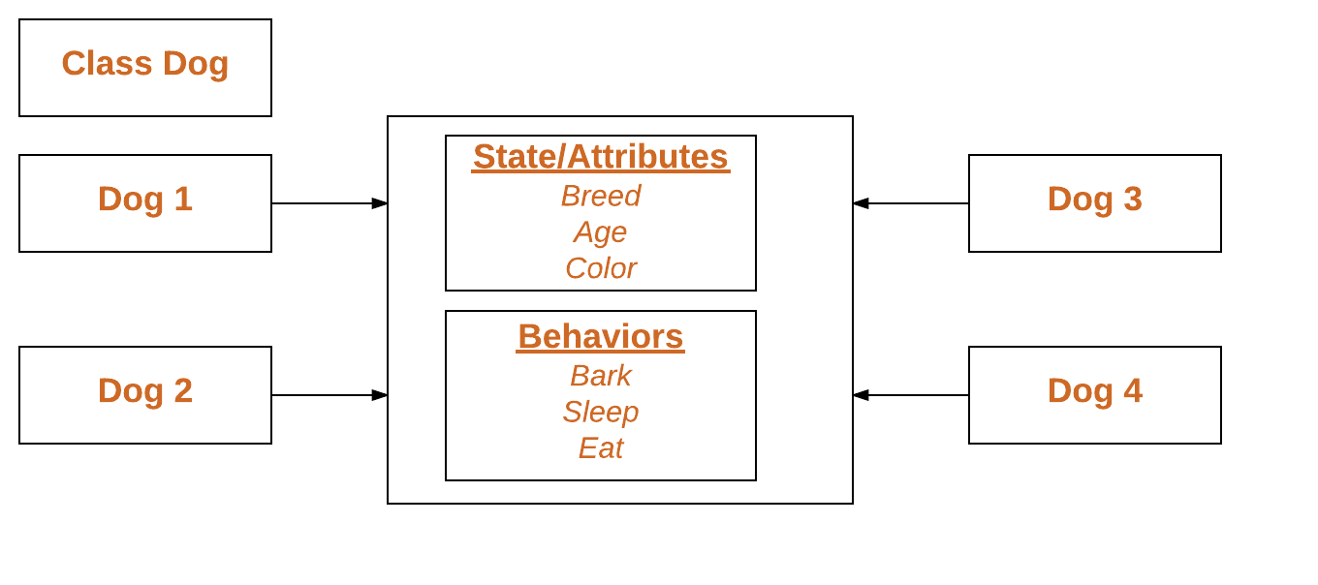
Structure of a Class and its instances

Slide 7
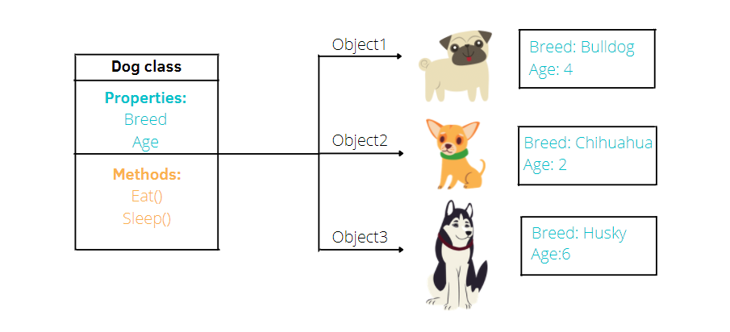
Classes and Instances

Slide 8
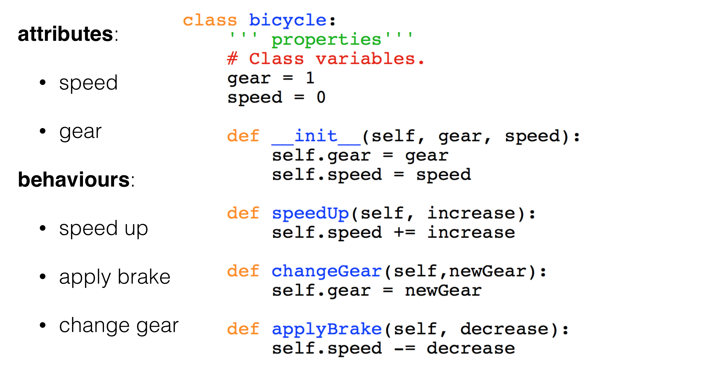
Structure of a Class in Code

Slide 9
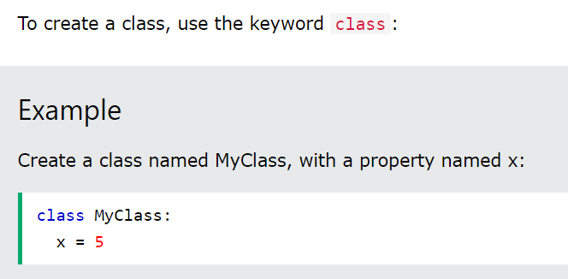
Creating a Class in Python

Slide 10
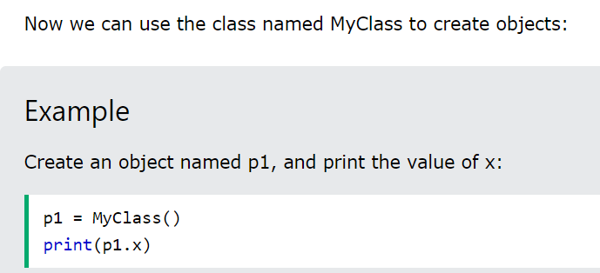
Creating an Object in Python

Slide 11
Class example
BEST PRACTICE: Never use a capital letter for your field names. Use underscores when indicating a space. You can also do a camel or pascal case.
class User:
pass
user1 = User()
user1.first_name = “John”
user1.last_name = “Doe ”
print(user1.first_name)
OUTPUT: John
This is an ‘instance’ of a class or commonly called as an ‘Object’
Field: A data attached to an Object
You can access the data or field by putting a dot (.) on the object followed by the field name.

Slide 12
Class scope
If you create a field name for a specific object, that field name will be only for that object.
Globally, they won’t exist unless defined or initialized.

Slide 13
Data types for fields
Having different data types for each field are allowed.

Slide 14
Setting attributes
If you set an attribute or field for one object while none for the other, only that specific object will be able to access that field.
If an object user1 and user2 both are initialized with a ‘first_name’. They will both have that field. user.first_name and user2.first_name will have no errors.
In case that user2 had an age field, while user1 had none. Putting user1.age will result to an ERROR indicating that it has NO ATTRIBUTE ‘age’.

Slide 15
Class features
Object Methods
Initialization/Constructors
Help text/Doc Strings

Slide 16
What is a constructor?
Special type of method used to initialize an object.
Responsible for assigning values to the data members of a class when an object is created.
Python calls its constructor the __init__ function, short for initialization.

Slide 17
The __init__() Function
The examples above are classes and objects in their simplest form and are not really useful in real life applications.
To understand the meaning of classes we have to understand the built-in __init__() function.
All classes have a function called __init__(), which is always executed when the class is being initiated.
Use the __init__() function to assign values to object properties, or other operations that are necessary to do when the object is being created:

Slide 18
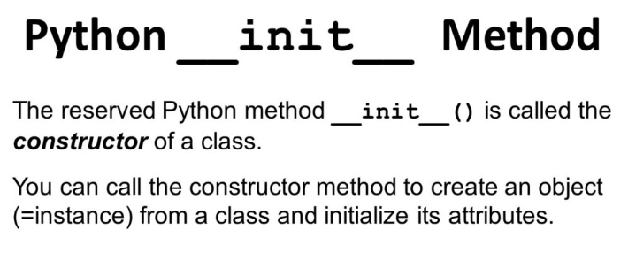

Slide 19
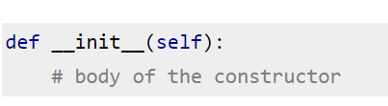
Syntax of constructor declaration
As we have seen in the above example that a constructor always has a name init and the name init is prefixed and suffixed with a double underscore(__). We declare a constructor using def keyword, just like methods.

Slide 20
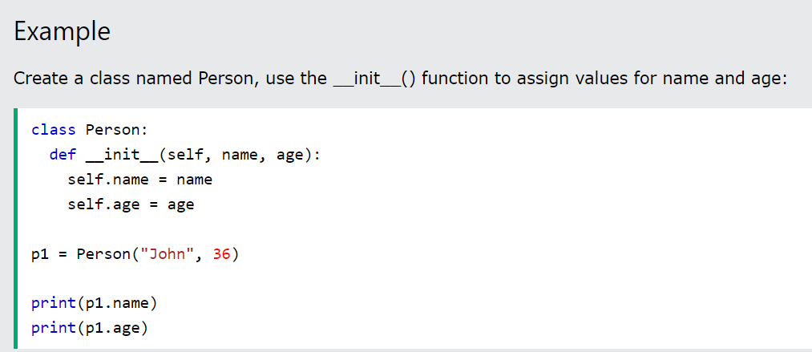
Using the __init__ function
Note: The __init__() function is called automatically every time the class is being used to create a new object.

Slide 21
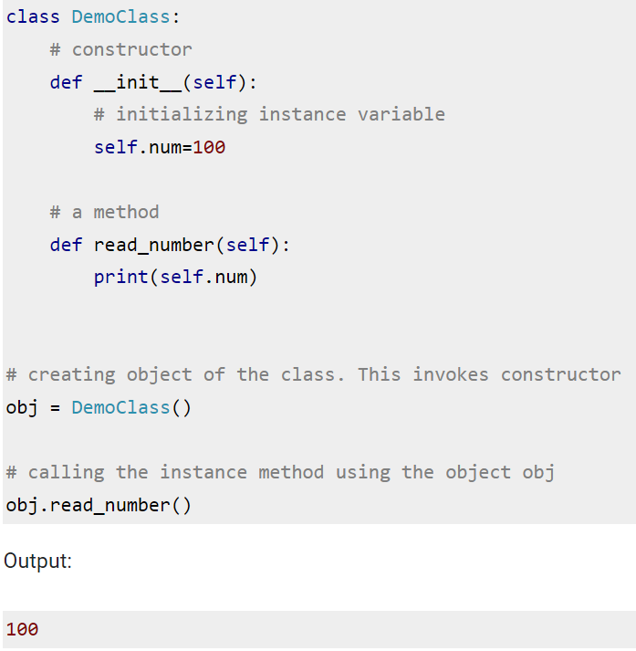
Constructor Example
Here we have an instance variable num which we are initializing in the constructor. The constructor is being invoked when we create the object of the class (obj in the following example).

Slide 22
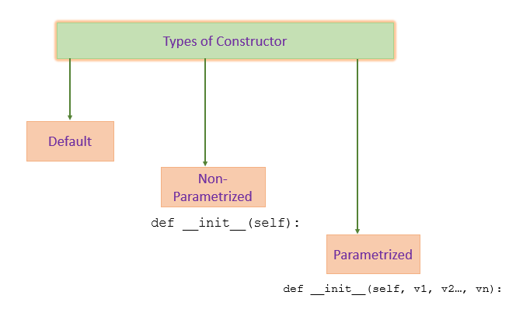
Types of Constructors

Slide 23
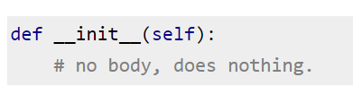
Python – default constructor example
Note: An object cannot be created if we don’t have a constructor in our program. Therefore, when we do not declare a constructor in our program, python does it for us. Let's have a look at the example below.
Example: When we do not declare a constructor
In this example, we do not have a constructor but still we are able to create an object for the class. This is because there is a default constructor implicitly injected by python during program compilation, this is an empty default constructor that looks like this:

Slide 24
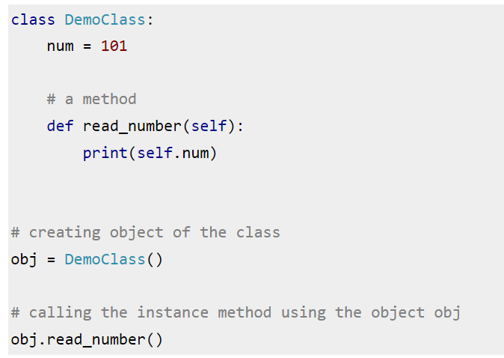
Class in default without a constructor

Slide 25
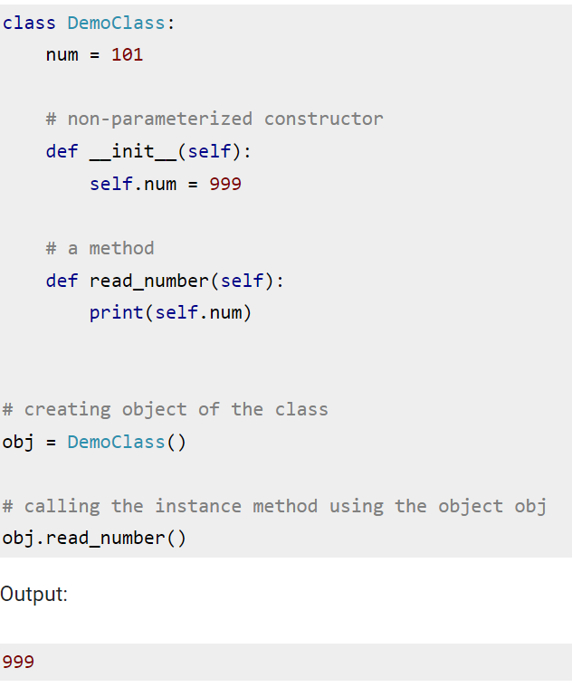
Class with a constructor

Slide 26
When to explicitly declare constructors?
You would declare the __init__ method explicitly when you want to define the initial state of an object when it is created. This allows you to set default values for attributes and perform any necessary initialization steps.
There may be some cases where you don't need to define an __init__ method explicitly. For example, if your class doesn't have any attributes, or if you don't need to initialize the attributes when the object is created, then you don't need to define an __init__ method.
NOTE: In general, you should always define an __init__ method for your class, because it is good practice to initialize the attributes of your objects as soon as they are created.

Slide 27
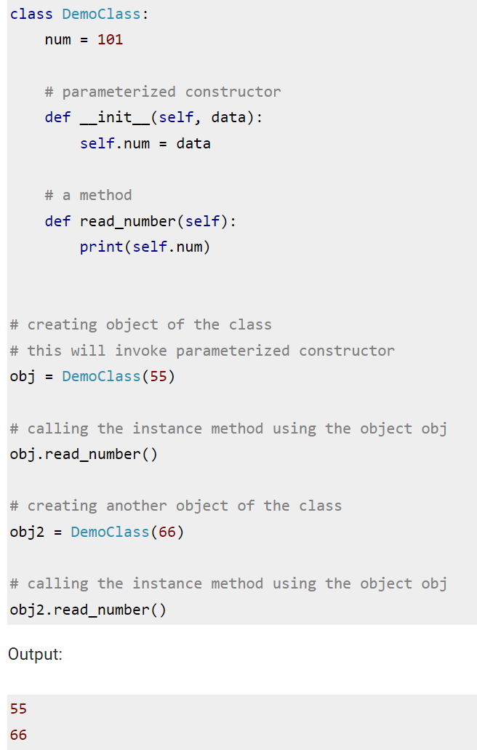
Python – Parameterized constructor example
When we declare a constructor in such a way that it accepts the arguments during object creation then such type of constructors are known as Parameterized constructors.
Such type of constructors, we can pass the values (data) during object creation, which is used by the constructor to initialize the instance members of that object.

Slide 28
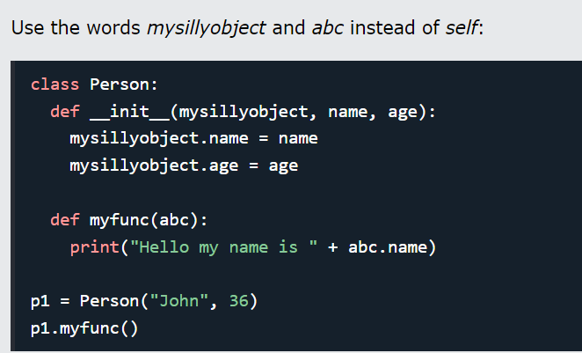
The ‘self’ parameter
A reference to the current instance of the class and is used to access variables that belongs to the class.
NOTE: It does not have to be named self , you can call it whatever you like, but it must be the first parameter of any function in the class

Slide 29
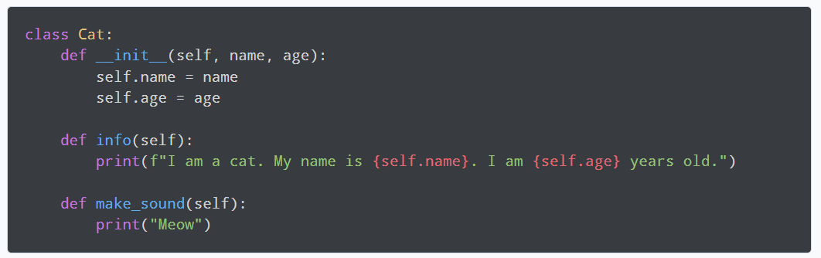
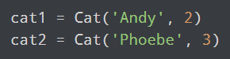
More examples to understand ‘self’
In object-oriented programming, whenever we define methods for a class, we use self as the first parameter in each case.
Let's look at the definition of a class called Cat.
In this case all the methods, including __init__, have the first parameter as self.
Class is a blueprint for the objects. Classes can be used to create multiple numbers of objects. Let's create two different objects from the above class.
The self keyword is used to represent an instance (object) of the given class. In this case, the two Cat objects cat1 and cat2 have their own name and age attributes. If there was no self argument, the same class couldn't hold the information for both these objects.
However, since the class is just a blueprint, self allows access to the attributes and methods of each object in python. This allows each object to have its own attributes and methods. Thus, even long before creating these objects, we reference the objects as self while defining the class.

Slide 30
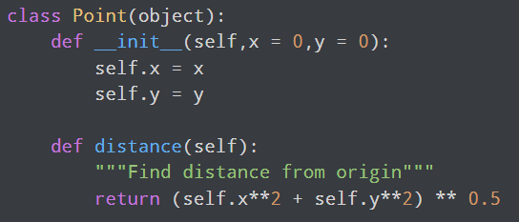
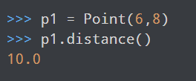
Why is self explicitly defined everytime?
Even when we understand the use of self, it may still seem odd, especially to programmers coming from other languages, that self is passed as a parameter explicitly every single time we define a method. As The Zen of Python goes, "Explicit is better than implicit".
So, why do we need to do this? Let's take a simple example to begin with. We have a Point class which defines a method distance to calculate the distance from the origin.

Slide 31
REMEMBER!
self represents the instance of the class.
self is always pointing to the current object.
By using self, we can access the attributes and methods of the class in Python.
self binds the attributes with the given arguments.
Python does not use the "@" syntax to refer to instance attributes.
In summary, self is a reference to the current instance of the class, and it allows you to access the attributes and methods of that instance. By convention, self is the first parameter of any instance method in a class, and it is used to bind the attributes of the instance to the arguments passed to the method.

Slide 32
Passing but not receiving automatically
Python decided to do methods in a way that makes the instance to which the method belongs be passed automatically, but not received automatically: the first parameter of methods is the instance the method is called on.
EFFECT: distinguishing between instance attributes (and methods) from local variables becomes EASIER!

Slide 33
Objects
All the objects have a state, behavior and identity.
State of an object - The state or attributes are the built in characteristics or properties of an object. For example, a T.V has the size, color, model etc.
Behavior of the object - The behavior or operations of an object are its predefined functions. For example, a T.V. can show picture , change channels, tune for a channel etc. in object oriented programming terminology the behavior is implemented through methods.
Object identity - Each object is uniquely identifiable. For example, the fridge can not become the T.V.

Slide 34
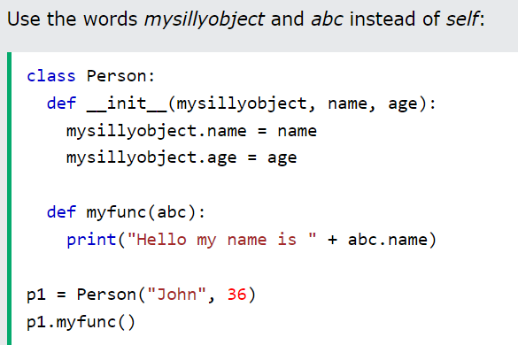
Another example using the self Parameter

Slide 35
Object Methods
Objects can also contain methods.
Methods in objects are functions that belong to the object.

Slide 36
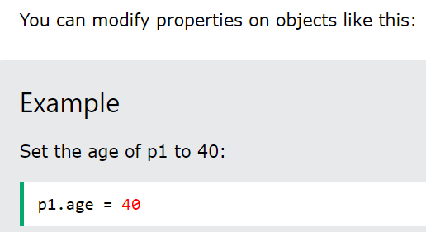
Modify Object Properties

Slide 37
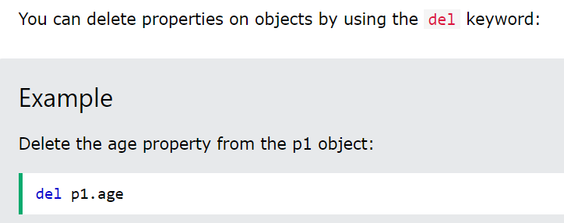
Delete Object Properties

Slide 38
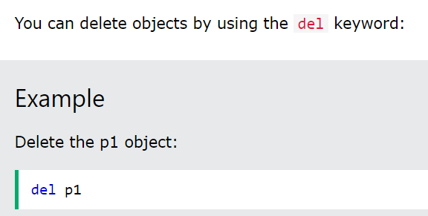
Delete Objects

Slide 39
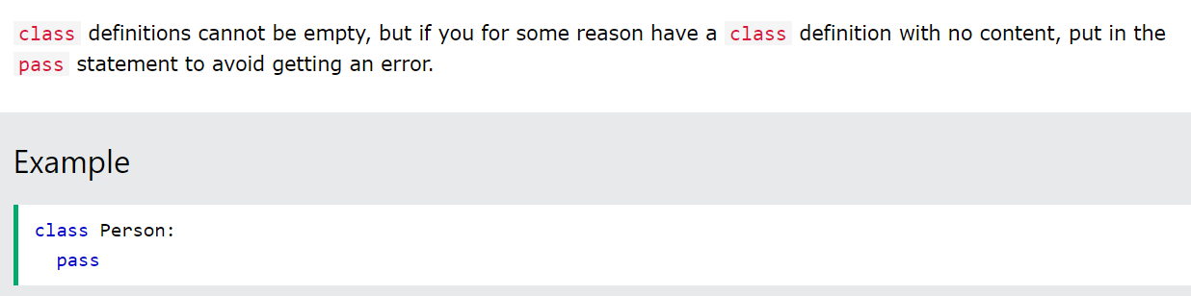
Pass statement

Slide 40
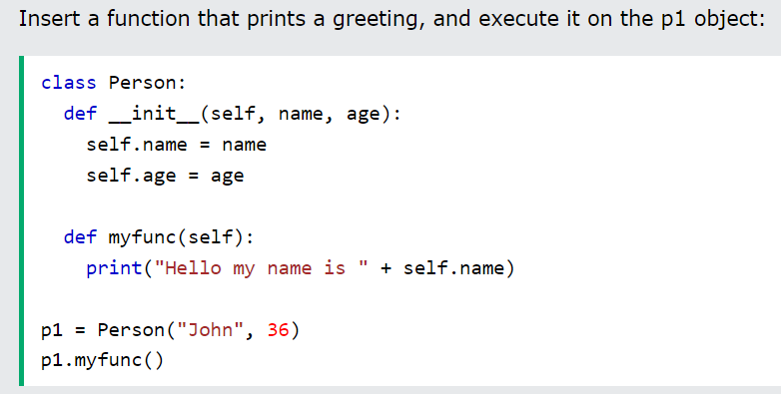
Creating a Class with Objects
Class
Constructor
‘self’ is indicating that the attributes are from itself
‘self’ is indicating that the method is from itself.
Object Method/Function
Object
Object calling its OWN method
Note: The self parameter is a reference to the current instance of the class and is used to access variables that belong to the class.

Slide 41
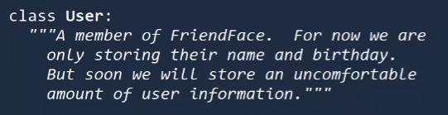
Doc string
Provides a more detailed information about the class.
The doc string can be added into the class by using a triple quote written after the first line of the class.

Slide 42
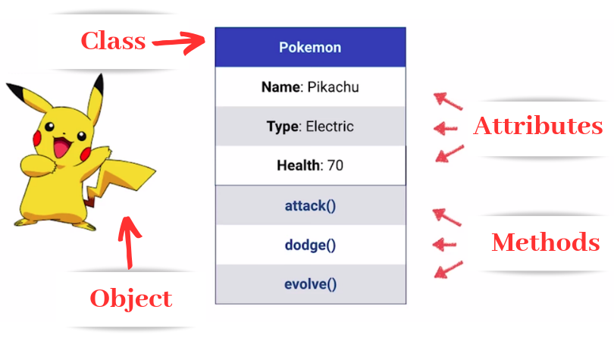




Slide 43





Can you make classes, objects, and methods of us?

Slide 44

Next meeting, Inheritance

